Slide 1
Experiential Work without Exercises:
Using RFT to Move Beyond Manuals
Emily Sandoz & Matthieu Villatte

Slide 2
Psychological Flexibility
Psychological flexibility is the ability to notice and react to your thoughts, feelings, and behaviour in order to give you the opportunity to take action towards important ends.
...and how do I do that, exactly?

Slide 3
We alter context to transform functions.

Slide 4
Which leads to distancing or augmenting.
It’s just a thought.
I’m a bad speaker. They are going to laugh at me!
It is really important for me to present this work!

Slide 5
And we do, so using an experiential approach.
RULES
CONTINGENCIES

Slide 6
Why an experiential approach?
Autonomy / Self efficacy
Flexibility
Individuality

Slide 7
Can we use language to alter the context experientially?
Yup.
How is that working for you?

Slide 8
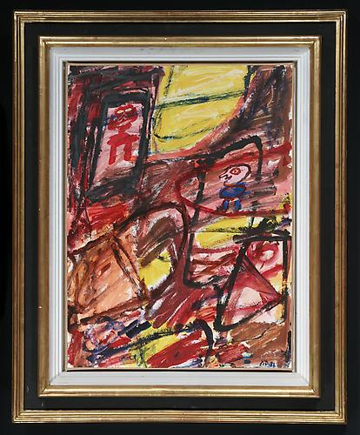
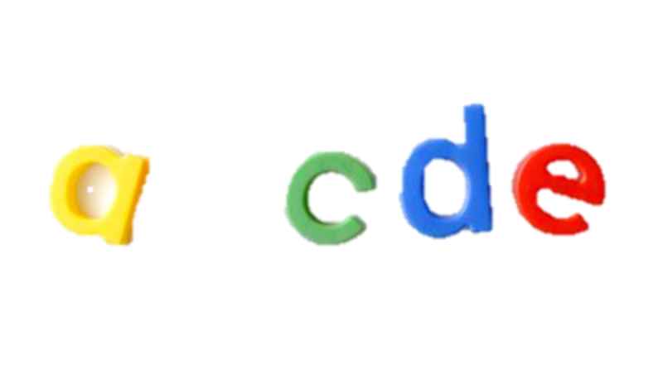
How can RFT help us in that process?
Framing.

Slide 9
Different types of framing = different effects
“I don’t want to feel this way”
Distinction/opposition: “What would your life look like if you didn’t feel this way?”
“I cut myself”
Condition/temporal: “How do you feel before/after?”
“I don’t know how to describe this feeling”
Analogy: “If this was a picture, what would you see on this picture?”
“I am a horrible person”
Perspective taking: “What would you tell your best friend if she said that?”
“I need to get a job”
Hierarchy: “What would getting a job contribute to?”

Slide 11
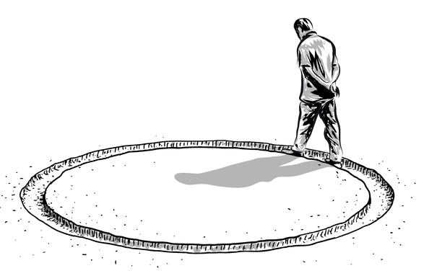
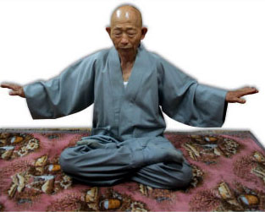
Distancing with experiential exercises
I can’t walk, I can’t walk, I can’t walk, …

Slide 12
Distancing
Noticing → Deictic framing (perspective taking) Analogy (metaphor)
Tracking → Conditional framing

Slide 13
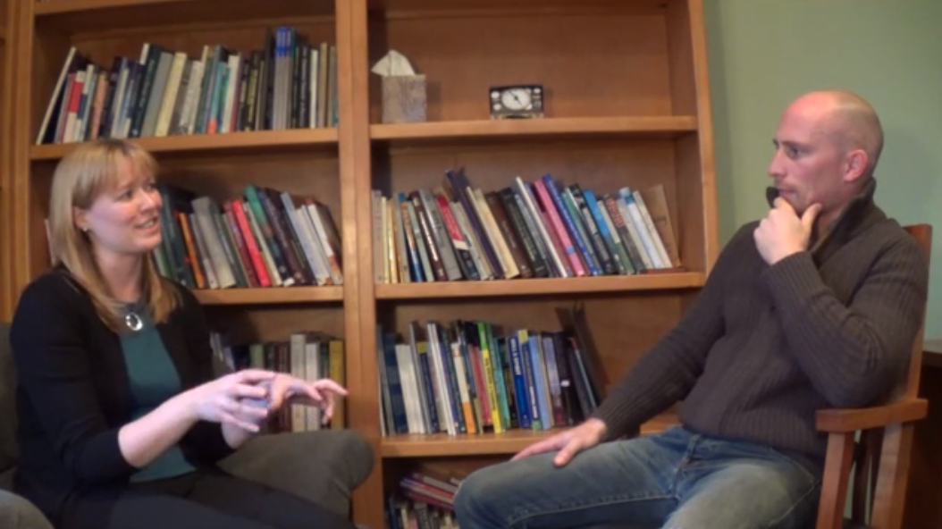
Distancing without Exercise

Slide 14
Distancing
Noticing → Deictic framing (perspective taking) Analogy (metaphor)
Tracking → Conditional framing

Slide 15
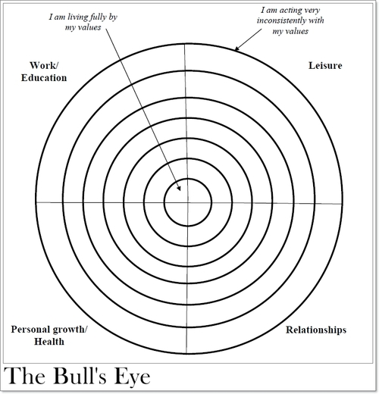
Augmenting with experiential exercises

Slide 16
Augmenting
Noticing → Deictic Framing (perspective taking)
Identify Value → Hierarchical framing

Slide 17
Augmenting without Exercises

Slide 18
Augmenting
Noticing → Deictic Framing (perspective taking)
Identify Value → Hierarchical framing

Slide 19
emilysandoz@louisiana.edu
matthieu.villatte@gmail.com

